Slide 1
Countries and Nationalities
Basic 1 – Unit 2 a – Countries of the world

Slide 7
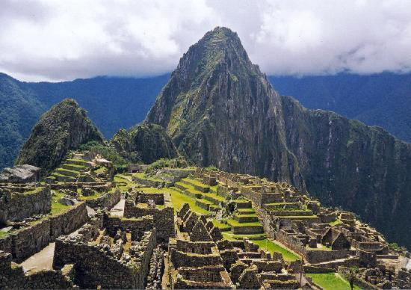
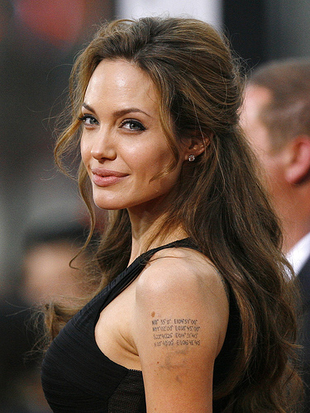
Where is Angelina Jolie?
Where is Angelina Jolie from?
She is in Cuzco.
She is from the U. S.

Slide 8
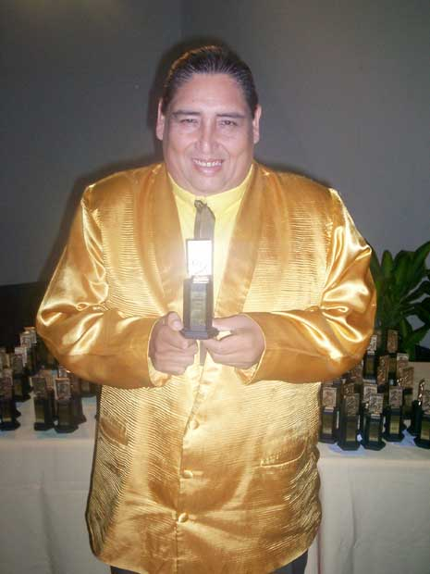
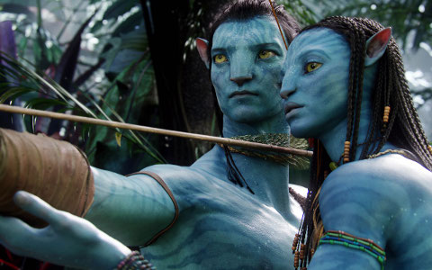
Who is your favorite singer?
What is your favorite movie?
My favorite singer is Tongo
My favorite movie is Avatar

